Slide 1

Secuura x VIT
Vishwakarma Institute of Technology , Pune
Department of Information Technology
Guide: Mr. Ganesh Shelke
1. Aditya Ulangwar SY IT-A 68
2. Shivam Aher SY IT-A 69
3. Kanak Bansal SY IT-A 70
4. Urvee Bhagwat SY IT-A 71
5. Shreyash Dabhade SY IT-A 75

Slide 2
Content
Introduction
Motivation
Literature Review
Objectives
Problem Statement
Proposed Methodology
System Workflow
Tools And Technologies Used
Algorithms
Results and Discussion
Conclusion
References

Slide 3
Introduction
This project is a secure Automated Document Verification System and is a high-integrity framework designed to digitize, extract, and validate sensitive academic and identity documents with zero-trust security. By combining spatial text mapping and LLM-based processing, with optional local deployment depending on security requirements, and a modular validation architecture capable of integrating with either centralized institutional registries or decentralized identity (Entra) systems, the system eliminates manual entry errors and mitigates the risk of document forgery while maintaining strict data residency.

Slide 4
Motivation
The increasing reliance on digital documents in academic and professional processes has created a need for faster and more reliable verification methods. Manual verification is often time-consuming and prone to human error, making it difficult to handle large volumes of documents efficiently. Additionally, automated systems must ensure that extracted information is accurate and that sensitive data is handled securely. This project is motivated by the need to develop a system that can automate document processing while maintaining trust, accuracy, and secure handling of information.

Slide 5
Literature Review
Sr. No | Abc et al. [2024] | Objectives claimed by authors in their paper | Methodologies used | Outcomes (from result & Discussion) | Gap Identified (Generally from Conclusion & Future scope)
1. | Berrios Moya et al. [2025] | To create a secure, privacy-preserving academic record verification system. | Utilizes zkEVM smart contracts with DIDs for identity management and IPFS for decentralized storage. | High security and privacy; prevents credential fraud while keeping student data private using Zero-Knowledge Proofs. | High computational cost for generating ZK proofs; potential scalability issues on public blockchains.
2. | Sinha & Rekha [2024] | To digitize documents and extract structured information from scanned and digital files. | Combines OCR engines with layout-aware libraries and LLMs to extract key-value pairs through contextual analysis. | Accurate key-value extraction and improved contextual understanding over traditional rule-based methods. | Difficulty in handling complex layouts and a heavy dependency on initial OCR scan quality.

Slide 6
Literature Review
Sr. No | Abc et al. [2024] | Objectives claimed by authors in their paper | Methodologies used | Outcomes (from result & Discussion) | Gap Identified (Generally from Conclusion & Future scope)
3. | Sajid et al. [2022] | To integrate AI, Blockchain, and RPA for transparent and automated credential verification. | Employs AI for authenticity analysis, Blockchain for immutable storage, and RPA for automated verification workflows. | A hybrid framework that reduces manual administrative work and increases trust in higher education. | Lack of empirical validation through real-world pilot projects and high technical integration complexity.
4. | Ji [2021] | To design a student data acquisition and extraction platform using big data. | Implements big data clustering and AI-driven extraction for automated monitoring and decision-making. | Real-time monitoring of student trends and automated decision-making for educational institutions. | Privacy concerns regarding mass data collection and potential bias in AI-driven analysis.

Slide 7
Literature Review
Sr. No | Abc et al. [2024] | Objectives claimed by authors in their paper | Methodologies used | Outcomes (from result & Discussion) | Gap Identified (Generally from Conclusion & Future scope)
5. | Ramakrishnan et al. [2012] | KTo extract layout-aware text from scientific PDF articles for text mining. | Uses spatial layout processing to detect text blocks, classified via rule-based methods into rhetorical categories. | Achieved a 0.91 F1-score in accurately identifying logical units (e.g., Intro, Methods) in scientific PDFs. | Limited to textual content; cannot process multi-modal data like images, tables, or formulas.
6. | Li et al. [2021] | To automate electronic resume information extraction with high efficiency. | Integrates a BERT model for feature extraction, BiLSTM for context abstraction, and a CRF layer for sequence decoding. | Superior performance in Named Entity Recognition (NER) for resume parsing compared to traditional models. | Performance drops significantly on resumes with unconventional or heavily graphical layouts.

Slide 8
Literature Review
Sr. No | Abc et al. [2024] | Objectives claimed by authors in their paper | Methodologies used | Outcomes (from result & Discussion) | Gap Identified (Generally from Conclusion & Future scope)
7. | Ateia et al. [2024] | To support scientific workflows through LLM-based information extraction. | Leverages few-shot learning with LLMs combined with prompt engineering and Retrieval-Augmented Generation (RAG). | High accuracy in extracting specific entities from research papers, reducing manual review time. | Risks of LLM hallucinations and difficulty in processing very long documents due to token limits.
8. | NICEDT [2024] (Paper 072) | To develop a secure document verification system for certificates. | Uses a hybrid encryption scheme (RSA/AES) supported by digital signatures and a centralized verification API. | Tamper-evident digital certificates providing a fast, one-click verification process for employers. | Centralized database creates a single point of failure and lacks blockchain's decentralization.

Slide 9
Literature Review
Sr. No | Abc et al. [2024] | Objectives claimed by authors in their paper | Methodologies used | Outcomes (from result & Discussion) | Gap Identified (Generally from Conclusion & Future scope)
9. | Tangwam et al. [2025] | To evaluate challenges in automated data extraction in complex environments. | Employs CNN-based deep learning paired with specialized shadow and noise filtering algorithms. | Improved classification accuracy and reliability in shadowed or low-quality data environments. | High hardware requirements and extreme sensitivity to environmental noise in data sources.
10. | Shrimal et al. [2025] | Aim is to fix unreliable LLM data extraction by treating JSON schemas as dynamic, optimizable interfaces rather than static human contracts. | PARSE uses ARCHITECT for iterative schema refinement and SCOPE for reflection-based extraction with guardrails. RELAY maintains backward compatibility by generating transformation code. | The system achieved a 64.7% accuracy boost on web data and a 92% error reduction in the first retry. It also reduced latency by 4.05s by minimizing the need for multiple reflection rounds. | The iterative process is computationally expensive for complex schemas and requires high-quality seed data. Additionally, the current framework does not yet support multi-modal (text + image) extraction.

Slide 10
Objectives
The central mission of this initiative is to harmonize high-precision automation with uncompromising data privacy protocols.
Generic AI Detection Agent: Engineering an intelligent agent capable of identifying critical verifiable data points—such as names, registration numbers, and dates—across various document types without the need for static, hardcoded templates.
Privacy-First "Zero-Knowledge" Architecture: Implementing a local extraction model (e.g., Llama-3) to process data entirely within a secure local boundary, ensuring that sensitive Student Personally Identifiable Information (PII) is never exposed to public cloud APIs.
Spatial Grounding for Hallucination Prevention: Validating AI-generated extractions by mathematically linking every word back to its exact physical [x, y] coordinates on the document, providing a "physical proof" of accuracy.

Slide 11
Problem Statement
Current document verification processes in academic and professional environments suffer from three primary vulnerabilities:
Privacy Risks: Uploading sensitive student data to public cloud AI APIs (e.g., GPT-4) risks data leaks and non-compliance with privacy regulations.
Hallucination & Accuracy: Standard AI extraction often "hallucinates" data, creating a need for physical grounding—linking digital data back to its exact coordinate on the original paper.
Verification Gaps: Extraction alone does not prove authenticity. There is a lack of automated "Truth Anchoring" against official registries or decentralized identity (DID) systems.

Slide 12
Proposed Methodology
Phase I – Secure Intake & Core Document Handling
Upload PDF document through the system interface
Generate SHA-256 hash of the document to create a unique doc_id
Store the file in a secure temporary directory configured for auto-deletion
Perform Spatial Text Mapping using:
pdfplumber for native PDF text
Local OCR engine for scanned documents
Generate searchable coordinate map:
{ "text": "word", "bbox": [coordinates], "page": n }
Phase II – Privacy-First AI Extraction & Grounding
Use local LLM agent to extract verifiable elements from the document
Identify important fields such as names, registration numbers, and dates
Map extracted data to a Canonical Metadata Schema
Perform Spatial Grounding by matching extracted values with coordinates from Phase I
Calculate Confidence Score using string match distance
Drop values that fall below the confidence threshold to maintain data integrity

Slide 13
Proposed Methodology
Phase III – Modular Validation Connector Framework
Use a Pluggable Connector Framework to verify extracted data against trusted sources
Path A – Centralized Registry Validation
Send REST API request to institutional registry
Compare extracted fields with official records
Return:
Boolean results (Match / No Match)
Reason codes (e.g., DOB mismatch)
Path B – Decentralized Identity Validation
Initiate Verifiable Presentation Request
Verify credentials using Microsoft Entra Verified ID
Cryptographically validate the student’s digital wallet credentials

Slide 14
Proposed Methodology
Phase IV – Security, Proof & Completion
Package verification results into an audit trail containing:
doc_id hash
Extracted JSON data
Validation results
Sign the audit payload using a private RSA key
Create cryptographic proof of the verification process
Perform mandatory cleanup by securely deleting all temporary files
Ensure no Personally Identifiable Information (PII) remains in the system

Slide 15
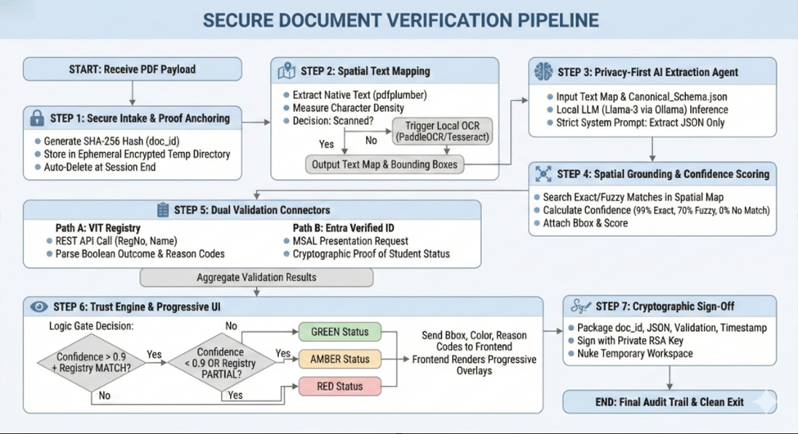
System Workflow/ Verification Pipeline

Slide 16
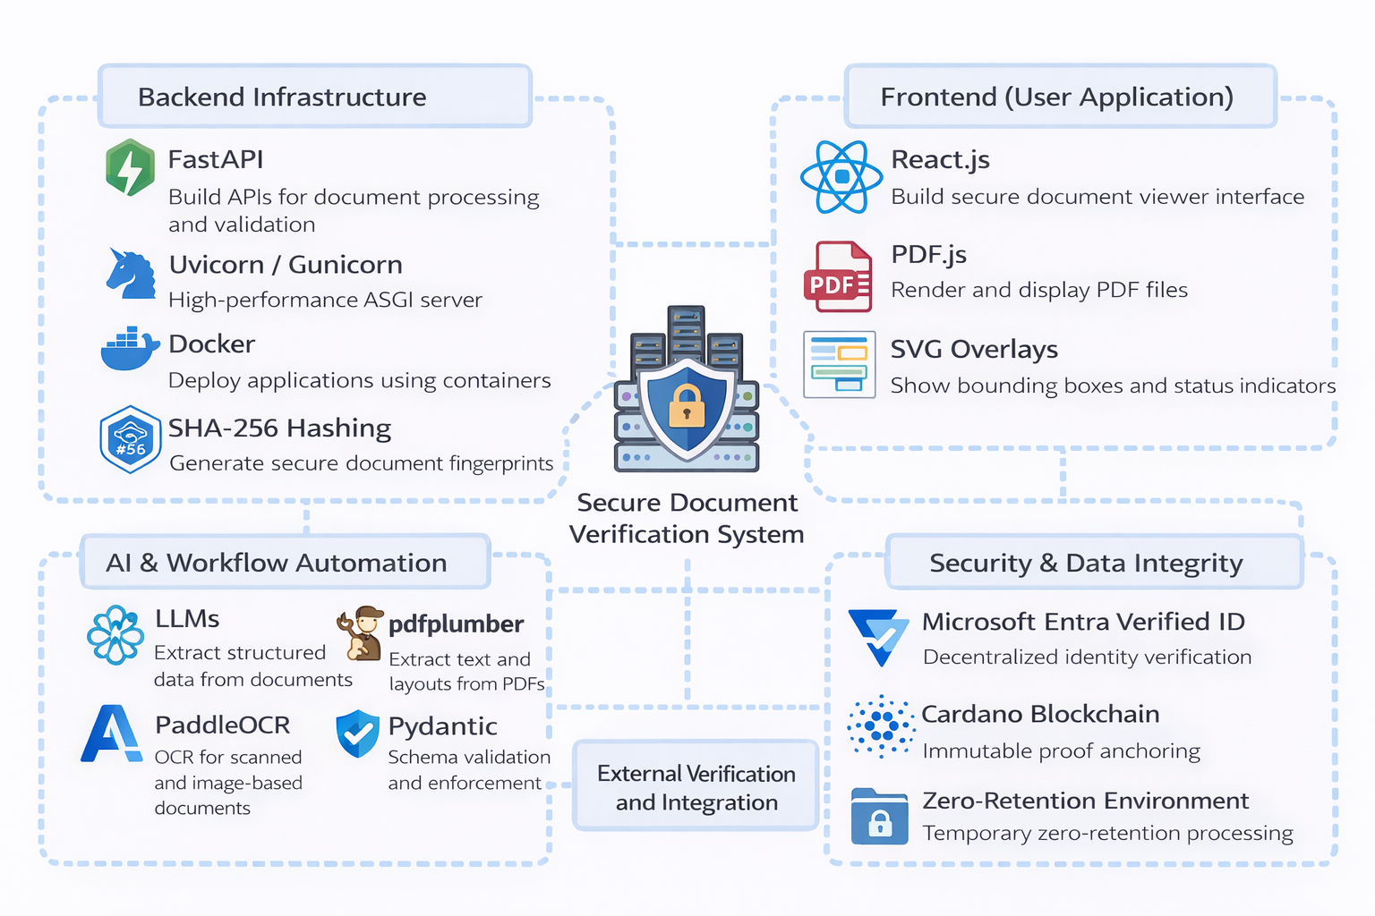
Tools And Technologies Used

Slide 17
Tools And Technologies Used
Backend Infrastructure
FastAPI: A high-performance Python framework used to build the backend API that manages document processing, extraction workflows, and validation logic.
Uvicorn / Gunicorn: ASGI servers used to run and manage the FastAPI backend services efficiently.
Docker: Containerization platform used to deploy and manage application services in isolated environments.
SHA-256 Hashing: Cryptographic hashing algorithm used to generate unique document fingerprints for secure document identification.
AI & Workflow Automation
Large Language Models (LLMs): Used for extracting structured information from unstructured PDF documents and mapping it to a canonical metadata schema.
pdfplumber: A Python library used for extracting textual content and layout information from PDF documents.
PaddleOCR: Optical Character Recognition engine used to extract text from scanned or image-based documents.
Pydantic: A data validation library used to enforce strict schema validation and ensure structured extraction accuracy.

Slide 18
Tools And Technologies Used
Frontend (User Application)
React.js: JavaScript library used to build the secure document viewer and verification interface.
PDF.js: Used for rendering PDF documents in the browser and enabling interactive document visualization.
SVG Overlays: Used to display spatial bounding boxes and color-coded verification indicators on the document viewer.
Security & Data Integrity
Microsoft Entra Verified ID: A decentralized identity verification system used to validate verifiable credentials without direct database access.
Cardano Blockchain (Preprod Testnet): Used to anchor cryptographic hashes of verification proofs to create an immutable audit trail.
Zero-Retention Processing Environment: Ensures that documents and extracted personal data are processed only in temporary memory and securely deleted after verification.

Slide 19
Tools And Technologies Used
External Verification and Integration
VIT Registry REST API: Used to verify academic records and institutional credentials.
Verification Connector Framework: A modular integration layer that allows the system to connect with institutional registries and decentralized identity services for validation.

Slide 20
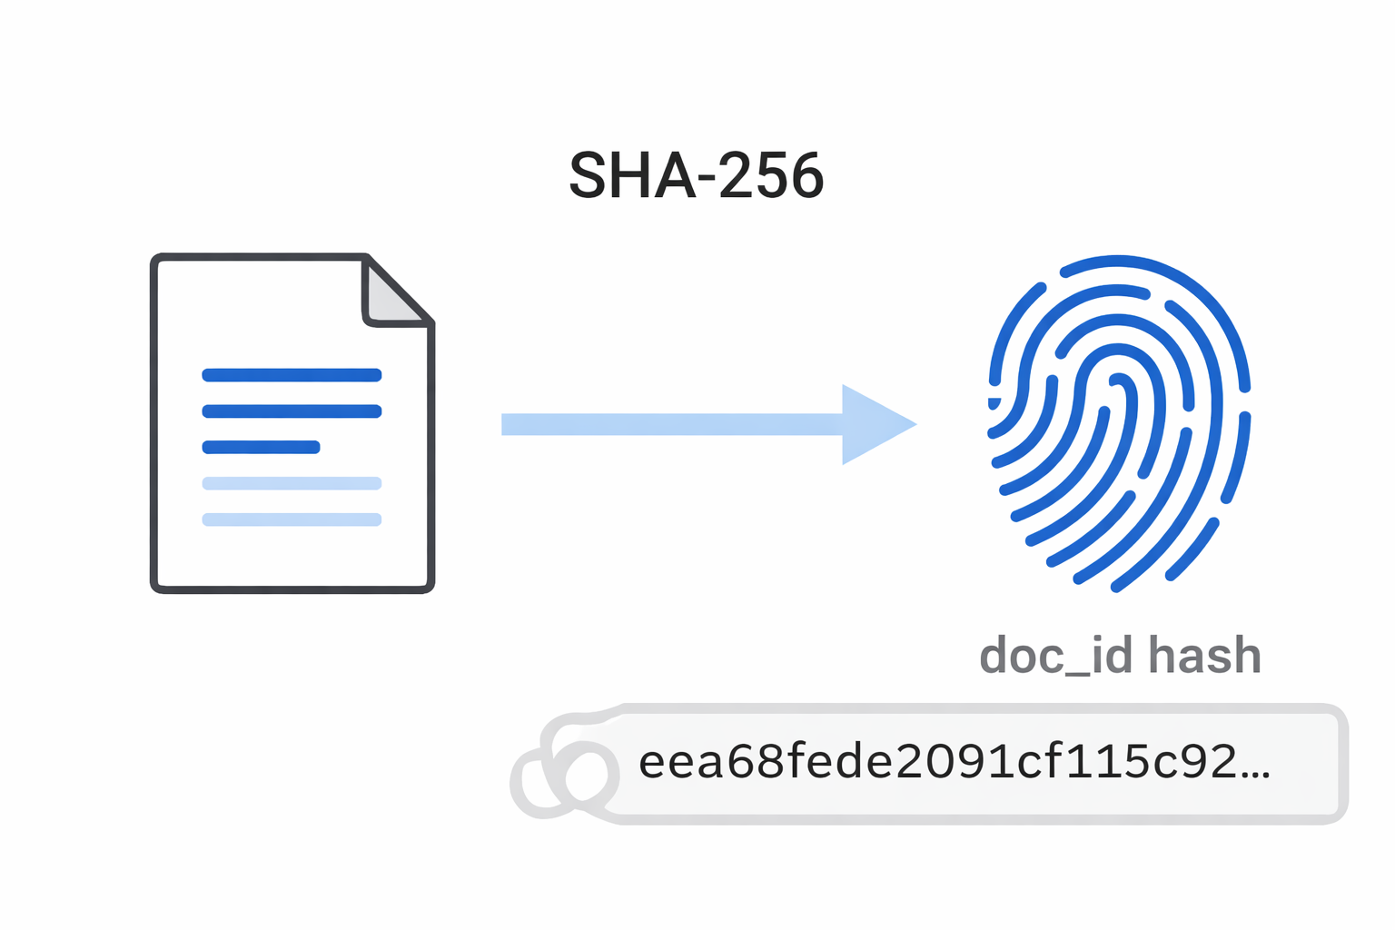
Algorithms
SHA-256 Cryptographic Hashing
SHA-256 is used to generate a unique cryptographic fingerprint (doc_id) for every uploaded document. When a PDF is received, the system computes a 256-bit hash value from the raw document bytes. This hash acts as a permanent identifier for the document without revealing its actual content. It ensures document integrity because even a small change in the document will produce a completely different hash. The hash is later used for verification and proof anchoring while avoiding storage of the original document data.

Slide 21
Algorithms
Spatial Coordinate Mapping Algorithm
The system performs layout-aware text extraction by mapping each word in the document to its exact position on the page. Using PDF parsing or OCR, the extracted text is stored along with bounding box coordinates representing its location in the document.
Coordinate representation:
[x0, y0, x1, y1]
These coordinates correspond to the rectangular region containing the word in the PDF. This mapping allows the system to maintain a direct connection between extracted data and the original document layout, enabling visual highlighting and accurate validation of extracted fields.

Slide 22
Algorithms
Deterministic Type Enforcement (Schema Validation)
The extracted information generated by the AI extraction agent is validated using strict schema validation rules implemented with Pydantic. This algorithm ensures that the extracted data conforms to predefined data structures defined in the Canonical Metadata Schema. If the AI output contains invalid formats, missing fields, or incorrect data types, the system rejects those values before they proceed to the verification stage. This acts as a deterministic gatekeeper between probabilistic AI extraction and the verification system, preventing incorrect or hallucinated data from entering the validation pipeline.

Slide 23
Results and Discussion
Results
The proposed system successfully demonstrates an automated pipeline for document verification. The system was able to process uploaded PDF documents, extract relevant information using AI-based extraction, and map the extracted data to a canonical metadata schema. Spatial text mapping allowed the system to link extracted fields with their exact locations in the document. The validation connector framework verified the extracted data against configured trust sources and returned Boolean verification results along with reason codes. The system also generated an audit record and completed secure cleanup of temporary data, ensuring that no sensitive information remained after processing.

Slide 24
Results and Discussion
Discussion
The implementation demonstrates that combining document processing, AI-based extraction, and structured validation mechanisms can significantly improve the efficiency of document verification. Spatial grounding helps ensure that extracted data corresponds to actual content in the document, reducing the risk of incorrect extraction results. The modular connector framework allows the system to integrate with different verification sources without changing the core extraction logic. The zero-retention processing approach also helps address privacy concerns by ensuring that sensitive document information is not permanently stored within the system.

Slide 25
Conclusion
Key Insights:
The combination of local AI extraction and decentralized identity (Entra) provides a robust framework for verifiable student data handling.
Success Against Objectives:
All milestones for Phase I through IV are documented, including strong privacy controls and cryptographic sign-off.
Feasibility Assessment:
The concept is highly viable for institutional deployment, offering a scalable path for automated, secure document verification.

Slide 26
References
References
[1] Juan Alamrio Berrios Moya, John Ayoade, and Md Ashraf Uddin, “A Zero-Knowledge Proof-Enabled Blockchain-Based Academic Record Verification System,” Sensors, vol. 25, issue 11, 2025, pp: 3450.
[2] Rasha Sinha and Mrs. Rekha B S, “Digitization of Document and Information Extraction using OCR,” Department of Information Science and Engineering, RV College of Engineering, 2024, pp: 1-6. [3] Meijiao Ji, “Design of Student Data Acquisition and Extraction Platform Based on Big Data Technology,” 2nd International Conference on Education, Knowledge and Information Management (ICEKIM), 2021, pp: 407-410.
[4] Cartic Ramakrishnan, Abhishek Patnia, Eduard Hovy, and Gully APC Burns, “Layout-aware text extraction from full-text PDF of scientific articles,” Source Code for Biology and Medicine, vol. 7, issue 1, 2012, pp: 7.
[5] Xiao Wei Li, Hui Shu, Yi Zhai, and ZhiQiang Lin, “A Method for Resume Information Extraction Using BERT-BILSTM-CRF,” 21st International Conference on Communication Technology (ICCT), 2021, pp: 1437-1442.

Slide 27
References
References
[6] Samy Ateia, Udo Kruschwitz, Melanie Scholz, Agnes Koschmider, and Moayad Almohaishi, “LLM-Based Information Extraction to Support Scientific Literature Research and Publication Workflows,” Communications in Computer and Information Science, vol. 2694, 2025, pp: 9.
[7] Lovnish Verma, Anita Budhiraja, and Sarwan Singh, “Blockchain-Based Certificate Verification System: A Decentralized Approach,” National Institute of Electronics & Information Technology, 2024, pp: 1-10.
[8] Hira Sajid, Javeria Kanwal, Saeed Ur Rehman Bhatti, Saad Ali Qureshi, Amna Basharat, Shujaat Hussain, and Kifayat Ullah Khan, “Resume Parsing Framework for E-recruitment,” 16th International Conference on Ubiquitous Information Management and Communication (IMCOM), 2022, pp: 1-8.
[9] "Integrating Artificial Intelligence, Blockchain, and Robotic Process Automation for Secure and Transparent Academic Credential Verification Systems," 2024.
[10] Anubhav Shrimal, Aryan Jain, Soumyajit Chowdhury, and Promod Yenigalla, “PARSE: LLM Driven Schema Optimization for Reliable Entity Extraction,” arXiv, 2025, pp:1-12.

Slide 28
Thank You

